Slide 1
Case Study – Quantum Airlines Role: Site Reliability Engineer
Mohammed Arif Shaikh

Slide 2
Background
Quantum Airlines has realized the power of cloud computing, automation and DevOps/SRE principles to address market and competitive forces that are consolidating through disruptive business models. A number of digital transformation initiatives are being embarked upon by the Airline, including migration and adoption of cloud computing and building platforms using cloud first strategy with full automation adopting the SRE principles providing Pace, Agility, Scalability and Reliability.
Problem Definition
For the past six months, the flight schedules dissemination to the partners/ GDSs is facing issues due to an archaic solution built several years ago which is currently unable to scale and has become highly unreliable. The situation is impacting operations and has resulted in Business dissatisfaction.
Objective
To build a scalable, highly available and high performing prototype for flight schedules service which is fully automated and brings in business agility. Approach includes
Capacity Planning
Automation
Logging & Monitoring
Auto healing
Deployment

Slide 3
HIGH-LEVEL SOLUTION
Service Architecture
Quantum airlines has adopted microservices application architecture as an enterprise standard for all customer facing web applications to have better scale of delivery and operations.
Microservices Architecture pattern enables each microservice to be deployed independently. While the total amount of functionality is unchanged, the application is broken into manageable chunks or services, which also enables each service to scale independently. This pattern also enables better fault isolation. Fault in one service will not degrade the efficiency or working of other services. Also, each microservice can have its own technology stack (‘polyglot stack’). Furthermore, each microservice can be enhanced without impacting its dependent services/clients using version management strategies.
API GATEWAY
An API Gateway is the single point of entry for your microservices-based application, presenting the API for each microservice and giving a clearer view of a decoupled application to the programmer.
API gateway brings in inbuilt security and throttling capabilities, which makes the on boarding of new partners easy
My choice for this prototype is AWS API gateway which is a fully managed service and empowers us with features like, monitoring and securing applications at scale, ease of publishing, Resiliency, API Lifecycle Management, API Operations Monitoring etc.
DEPLOYMENT
AWS cloud platform is the proposal for this solution. We can use AWS RDS for storage service, AWS SNS and SQS for asynchronous communication, AWS API Gateway for API proxy and AWS ECS for deploying and scaling services. Amazon offers an auto-scaling out-of-the-box for ECS. We choose the desired, minimum and a maximum number of tasks, create one or more scaling policies, and Service Auto Scaling handles the rest.
Quantum airlines can take full advantage of the reliability, availability, performance, and scale of the AWS platform, essential to which are integrations with AWS security and networking services..
Deployment of the services is managed by Jenkins CI, which creates a Docker image whenever it finds an update on GitHub for a service. Once the image is created, Jenkins uploads it to the EC2 Container registry using IAM roles and generates a new Task definition to deploy the container updates.

Slide 4
Automation & CI , CD
Each service is tested using docker-compose on a local machine first, which replicates the environment in production. it gives a clear view of the functionality of the application and the docker container itself before it is deployed to servers. Multiple containers for the same service can also be launched on the local system using docker-compose. However, proper scaling tests are done on the Dev/QA environments.
The version management of source code for each service is managed on GitHub and container image version is managed on AWS ECR.
Logging & Monitoring
Centralised log management is a trivial necessity for microservices architecture, where each container for the given service can send their logs. Recommendation for this use case is to use Splunk for logging.
Asynchronous logging
Data Obfuscation (masking)
Logging at gateway
Request traceability
Propose to use monitoring AWS offers for containers, coupled with cloud watch alarms and slack alerts. Appdynamics for the detailed monitoring.
Inclusion of auto-healing for a specific threshold of failure based on alerts and reversal to earlier version
BUSINESS BENEFITS
Agility – Microservices by design helps in agility. A change in service requires only that particular service to be tested. And with service versioning in place, other services/client dependent on this service can keep running with an older version of the service.
Microservices architecture is high on efficiency. Since the individual service can be scaled up or down based on the demand. Hence increasing infrastructure efficiency. This leads to lesser infrastructure cost.
It eases out the technology decisions. Since each microservice can be in different technology. This simplifies hiring decisions also quite a lot.

Slide 5
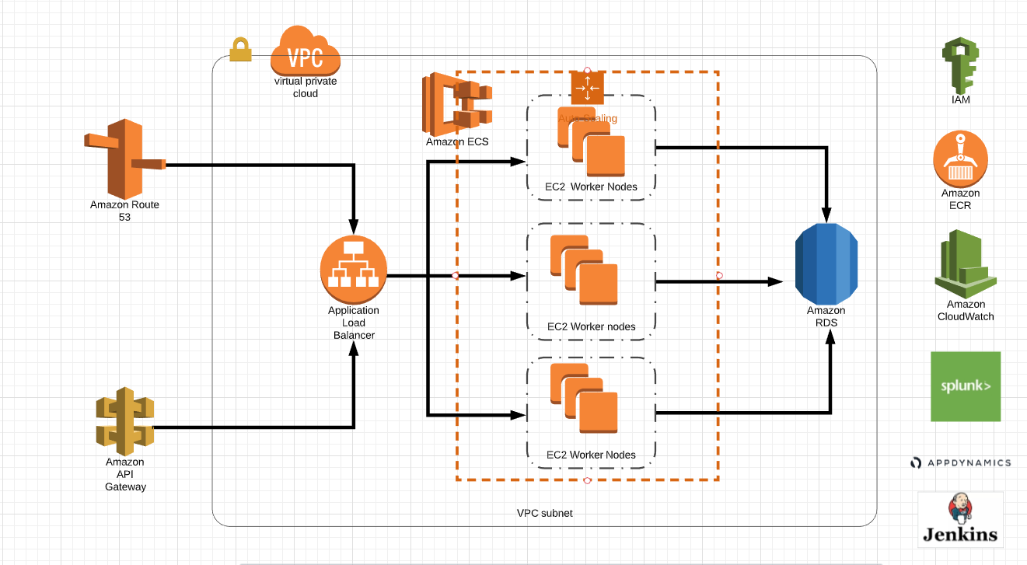
Deployment Architecture

Slide 6
CI CD PIPELINE

